Slide 1
BANKING ANALYTICS
PRESENTED BY G.S.V.DEDEEPYA

Slide 2
PROJECT CONTENTS
Introduction
Data exploration & data cleaning
Loading data
Data visualization
Dashboard presentation
Observations and Recommendations

Slide 3
INTRODUCTION
Banking analytics is the process of collecting, analyzing, and interpreting data within the banking industry. By extracting valuable information from various sources, such as customer transactions, market trends, risk assessments, and operational performance, financial institutions can gain valuable insights and make informed decisions
For example Banks find it hard to give loans to the people due to their insufficient or non-existent credit history. Because of that, some consumers use it as their advantage by becoming a defaulter. Banks give different types of loans . This will ensure that the applicants capable of repaying the loan are not rejected.

Slide 4
DATA EXPLORATION &DATA CLEANING:
The data given to the project deals with personal details, professional and credential background of the customers of the bank. The dataset has two files finance_1 & finance_2.These both files have 39000 record and has common column id.
In preparing our dataset for analysis, the first crucial step involved meticulous data cleaning to ensure the integrity and relevance of the information. Here are the key actions taken:
Removing Duplicate or Irrelevant Observations: Duplicate entries and irrelevant observations, such as descriptions and loan titles, were identified and systematically removed from finnance1 file. This process aimed to streamline the dataset, keeping only the essential information for our analysis.
Handling Empty (Null) Values: Null values in specific columns, including “Revol_util”, “last_credit_d_pull”, and “next_pymnt_d”, were addressed. To maintain the dataset’s completeness and accuracy, records with null values in these columns were removed.
Eliminating Redundant column: The column `Payment_plan` from finace _1 contained a single constant value ’n’ across all records, rendering it irrelevant for our analysis. To optimize the dataset’s simplicity and efficiency, the entire column was removed.
These data cleaning steps were crucial in ensuring that the dataset used for subsequent analysis was free from redundancies, irrelevant information, and missing values, setting the stage for a more accurate and insightful examination of the chosen key performance indicators.

Slide 5
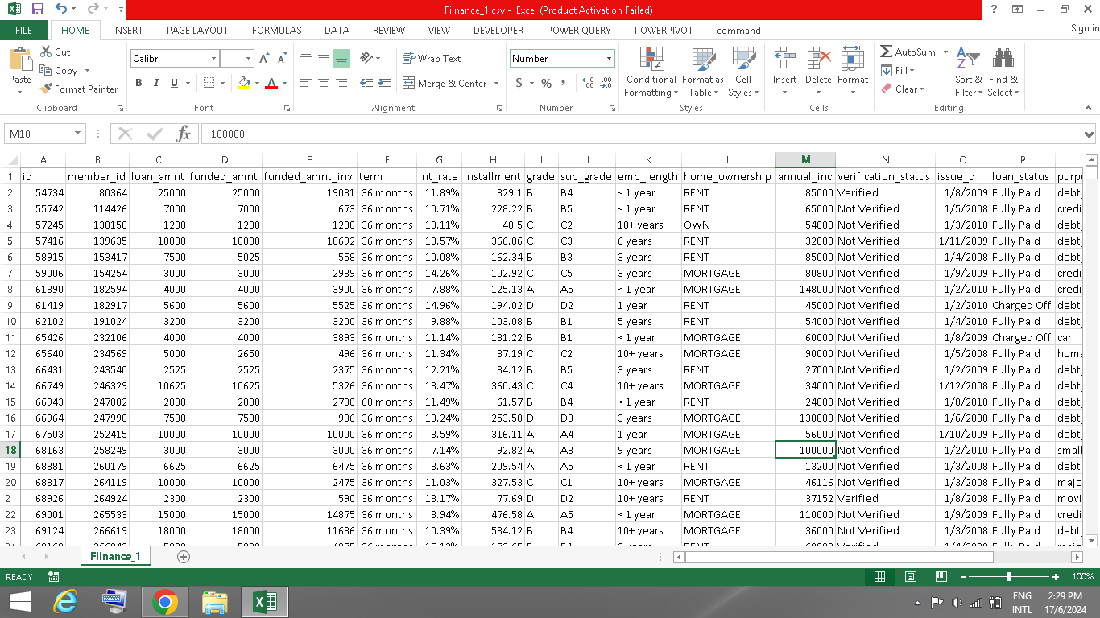
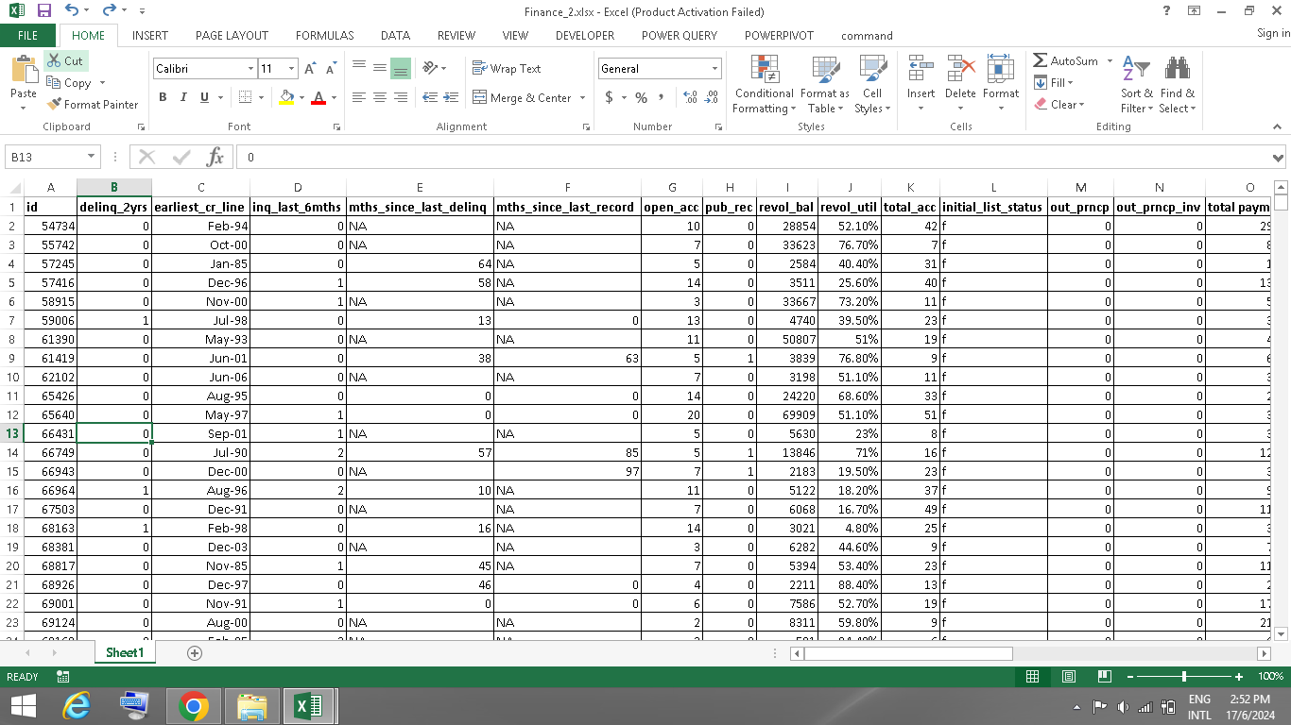
After cleaning process data files is as shown below

Slide 6
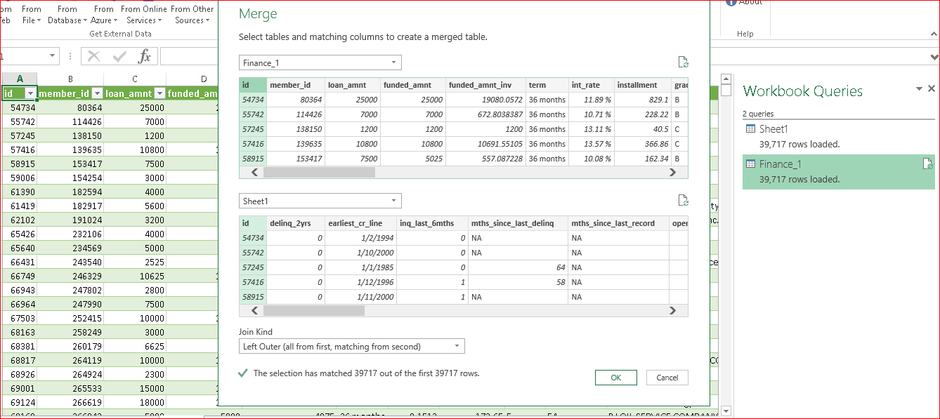
LOADING DATA:
First loaded the both files by using power query and merged them by using merge query by using common column “id”. This is as shown in below image

Slide 7
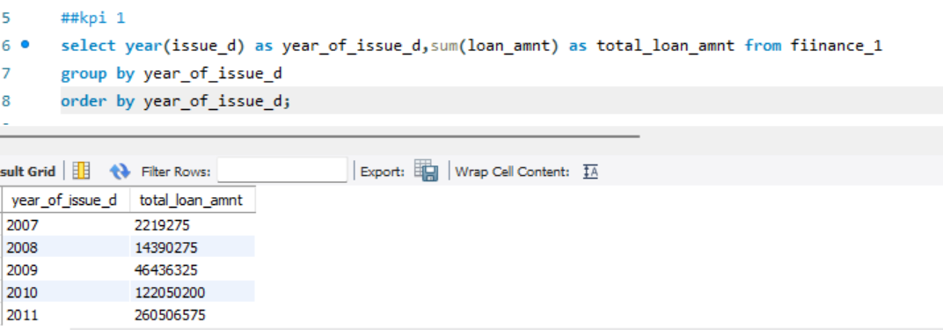
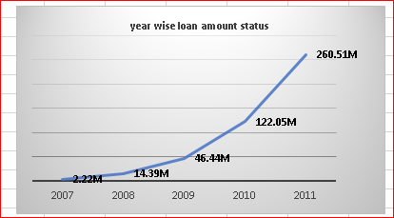
DATA VISUALIZATION
YEAR WISE LOAN AMOUNT STATS:
Analysis:
Most people earning less than 3 lakh per year seek loans for a variety of purposes, while those earning more than 3 lakh seek loans exclusively for debt consolidation and home improvements. Percentage increase in loan amounts between consecutive years –
Though there is a substantial increase in loan amounts but growth rates have reduced yearly.
Recommondations:
The customers should have more time to repay a loan with longer loan terms.
The interest rate charged by the lender can impact the loan amount. A higher interest rate can increase monthly payments, which may affect the loan amount.

Slide 8
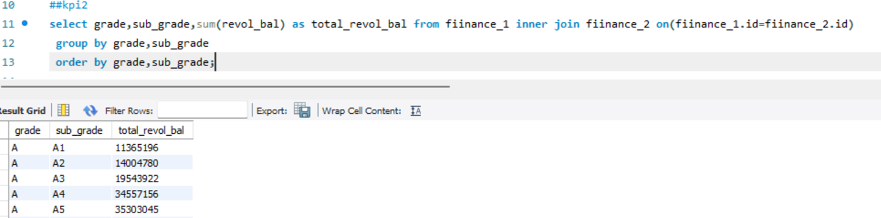
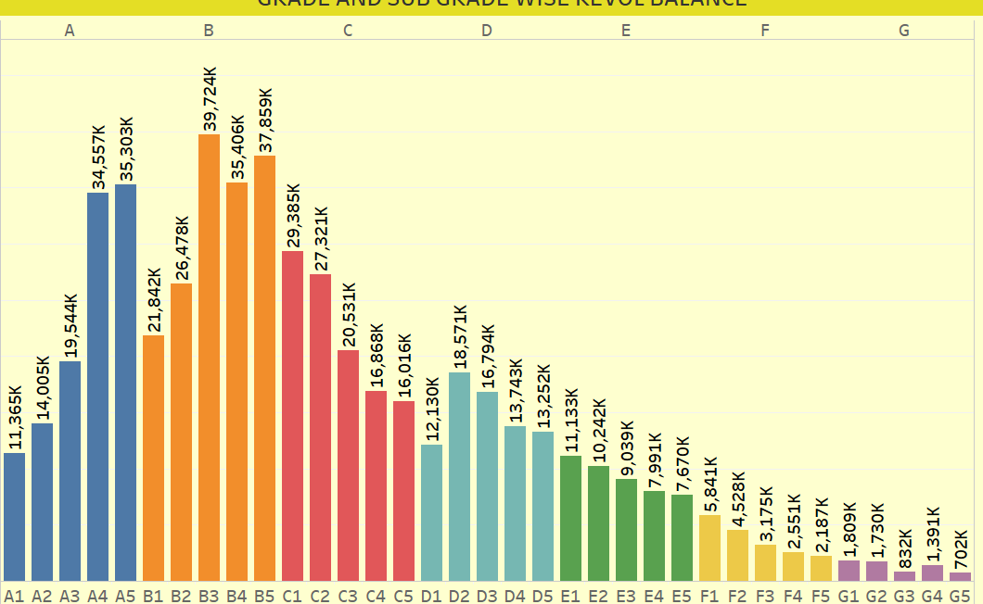
GRADE AND SUB GRADEWISE REVOL BALANCE:
Analysis:
● The total loan amount for Grade B is $ 39,724k which is the highest among all grades.
● Overall, the analysis of grade and subgrade wise loan amounts provides an understanding of the distribution of loan amounts across different risk level categories. Higher-grade customers tend to have higher loan amounts, while lower grade customers have relatively lower loan amounts.
Recommendations:
Considering the salary bracket of less than 1 lakh, it is recommended to sanction a lower loan amount to Grade A, B, and C borrowers specifically for the purposes of debt consolidation and credit card management.
Bank should aim to diversify their loan portfolio across different grades and sub-grades. This strategy would help them to reduce risk by balancing higher-risk loans with lower-risk loans.
Educating customers about the loan process, credit management, and responsible borrowing practices can contribute to better loan performance. higher loan amounts, while lower-grade customers have relatively lower loan amounts.

Slide 9
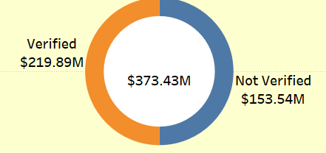
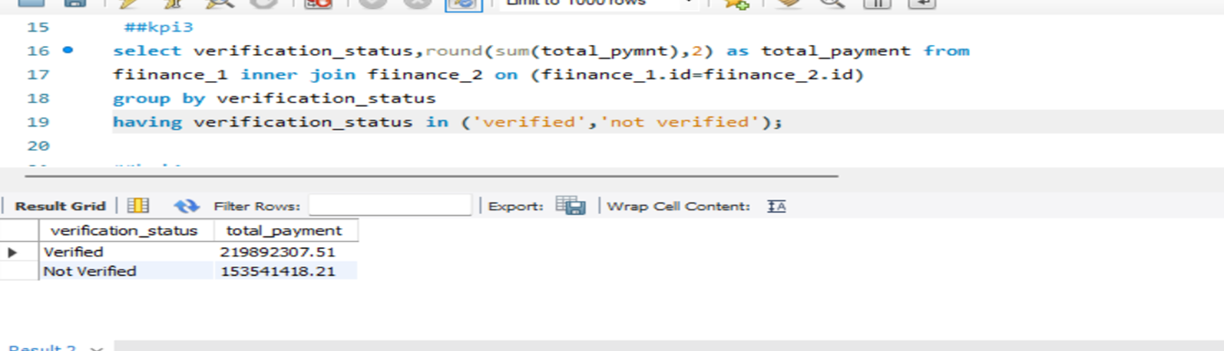
Total Payment for Verified Status Vs Total Payment for Non-Verified Status:
Analysis:
● The total loan amount for Grade B is $161 M (30.35%), which is the highest among all grades.
● Overall, the analysis of grade and subgrade wise loan amounts provides an understanding of the distribution of loan amounts across different risk level categories.
Higher-grade customers tend to have higher loan amounts, while lower-grade customers have relatively lower loan amounts.
Recommendations:
● Considering the salary bracket of less than 1 lakh, it is recommended to sanction a lower loan
amount to Grade A, B, and C borrowers specifically for the purposes of debt consolidation and
credit card management.
● Bank should aim to diversify their loan portfolio across different grades and sub-grades. This
strategy would help them to reduce risk by balancing higher-risk loans with lower-risk loans.
● Educating customers about the loan process, credit management, and responsible borrowing
practices can contribute to better loan performance.

Slide 10
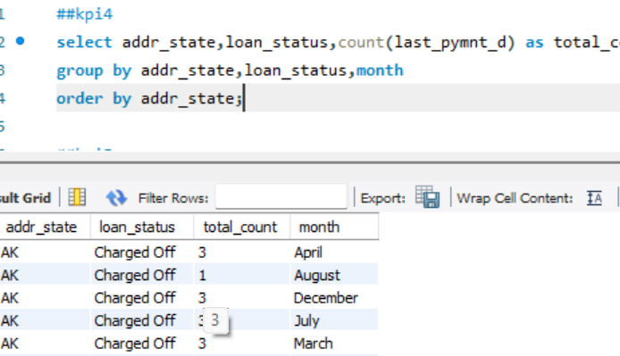
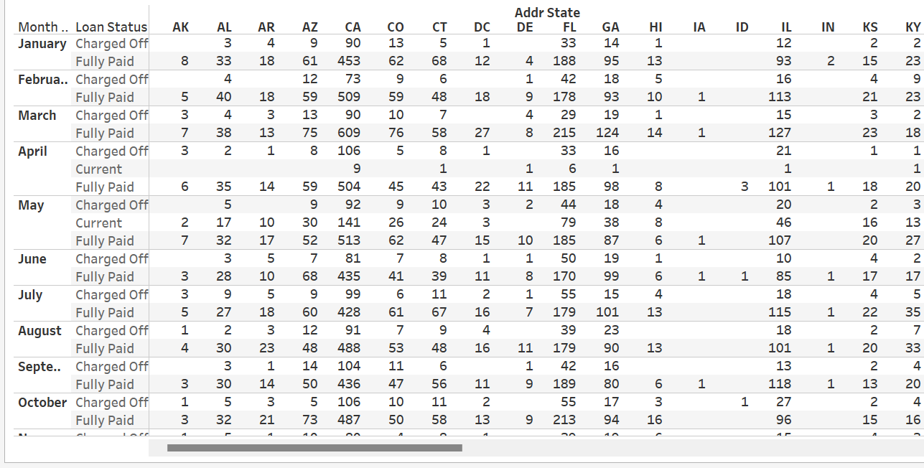
STATEWISE AND MONTHWISE LOAN STATUS:
Analysis:
As per the analysis, mortgage has the highest loan count, i.e. significant number of customers who have mortgages on their properties. Rent is the second most common home ownership status, indicating a large number of customers who are renting their homes.
Recommendations:
Collaborate with real estate agents, property managers, or landlords to establish referral programs.
This can help reach potential customers within the real estate industry.

Slide 11
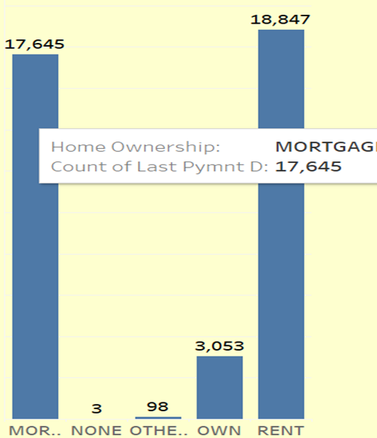
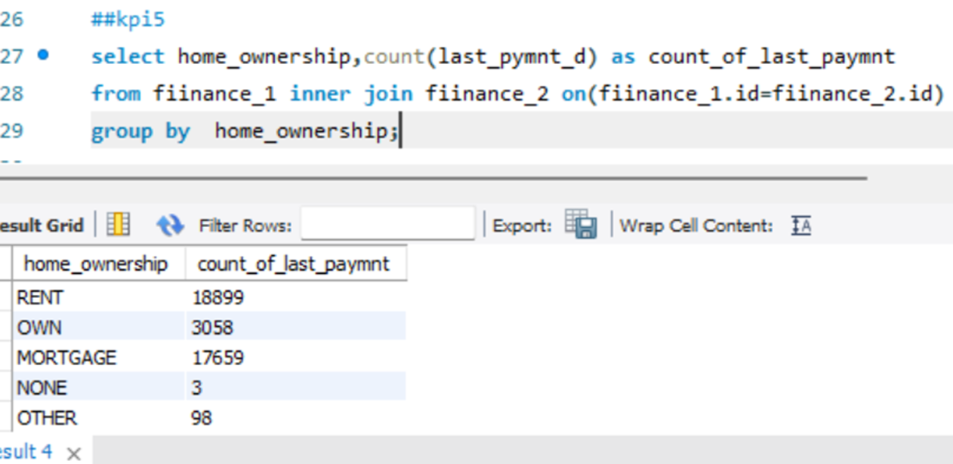
HOME OWNERSHIP VS LAST PAYMENT DATE STATS:
Analysis:
As per the analysis, mortgage has the highest loan count, i.e. significant number of customers who have mortgages on their properties.
Rent is the second most common home ownership status, indicating a large number of customers who are renting their homes.
Recommendations:
Collaborate with real estate agents, property managers, or landlords to establish referral programs. This can help reach potential customers within the real estate industry.

Slide 12
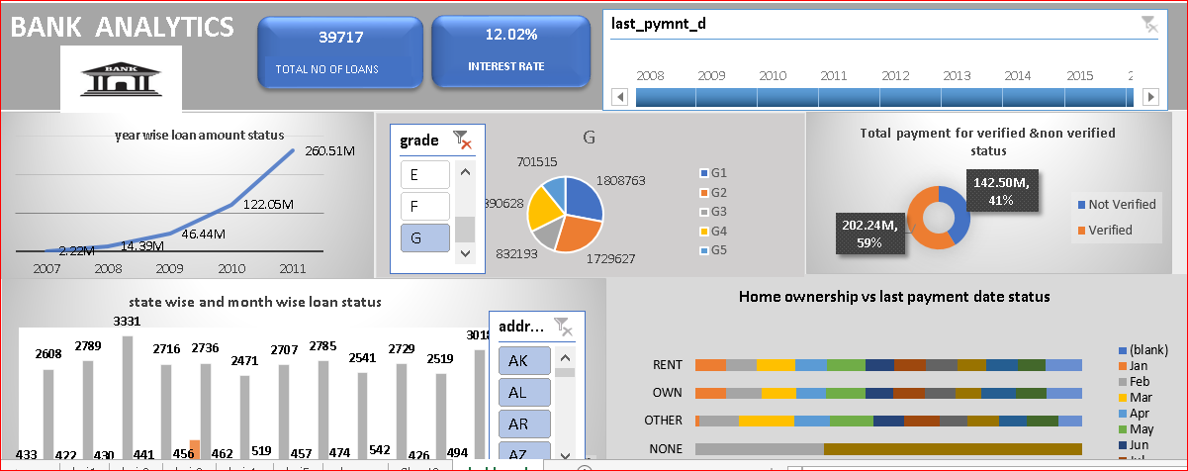
SCREENSHOT OF EXCEL DASHBOARD:

Slide 13
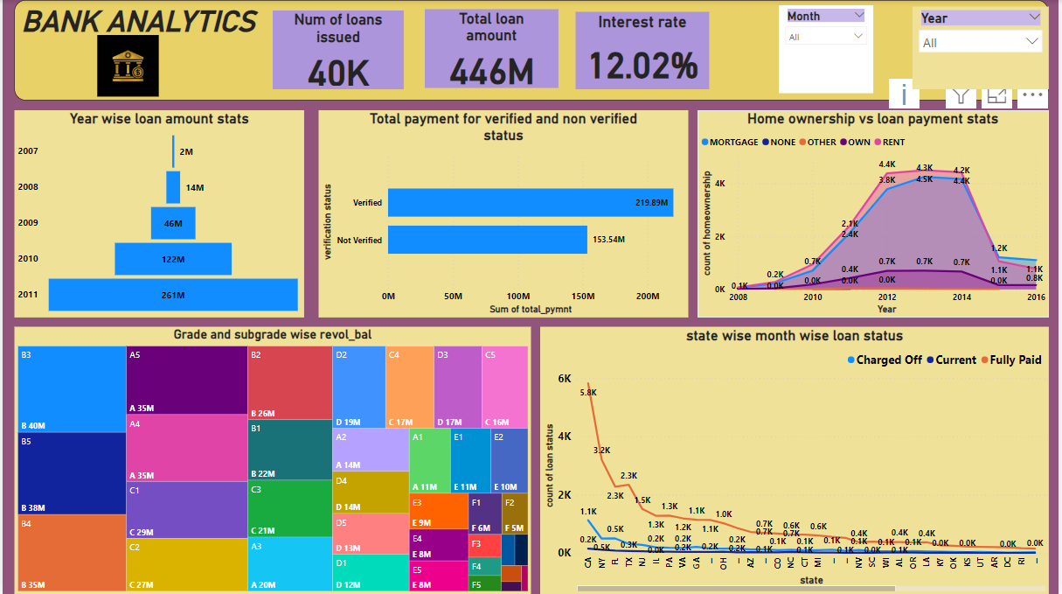
DASHBOARD OF POWER BI:

Slide 14
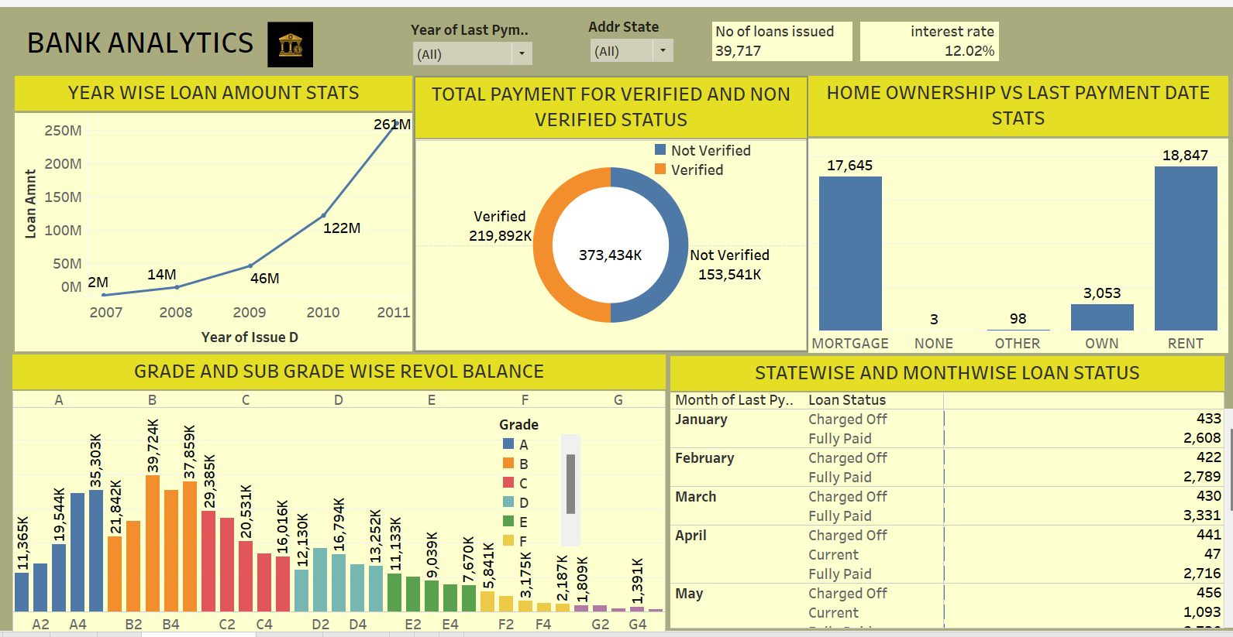
SCREENSHOTS OF DASHBOARDS (TABLEAU DASHBOARD):

Slide 15
WHAT WE LEARN:
Importance of key performance indicators in data analytics.
Parameters to be assessed after loan distribution by banks e.g. homeownership, revolving balance, grades, verification status, etc.
How all these parameters are extracted from data to make Pivot tables, charts and beautify interactive and mesmerizing dashboards in Excel, Power BI and Tableau using slicers, filters, icons and images. Writing queries for the same in SQL.
CHALLENGES DURING PROJECT:
True challenge was to assemble our classroom knowledge and to put it into this real-world situation.

Slide 16
THANK YOU

